Slide 1
Topic 6. Classification

Slide 2
Examples of Classification
An online banking service must be able to determine whether or not a transaction being performed is fraudulent, on the basis of the IP address, past transaction history, and so forth.
On the basis of DNA sequence data for a number of patients with or without a given disease, a biologist would like to figure out which DNA mutations are disease causes.
A patient with a set of symptoms that could possibly be attributed to one of three types of diabetes. Which one does the individual have?

Slide 3
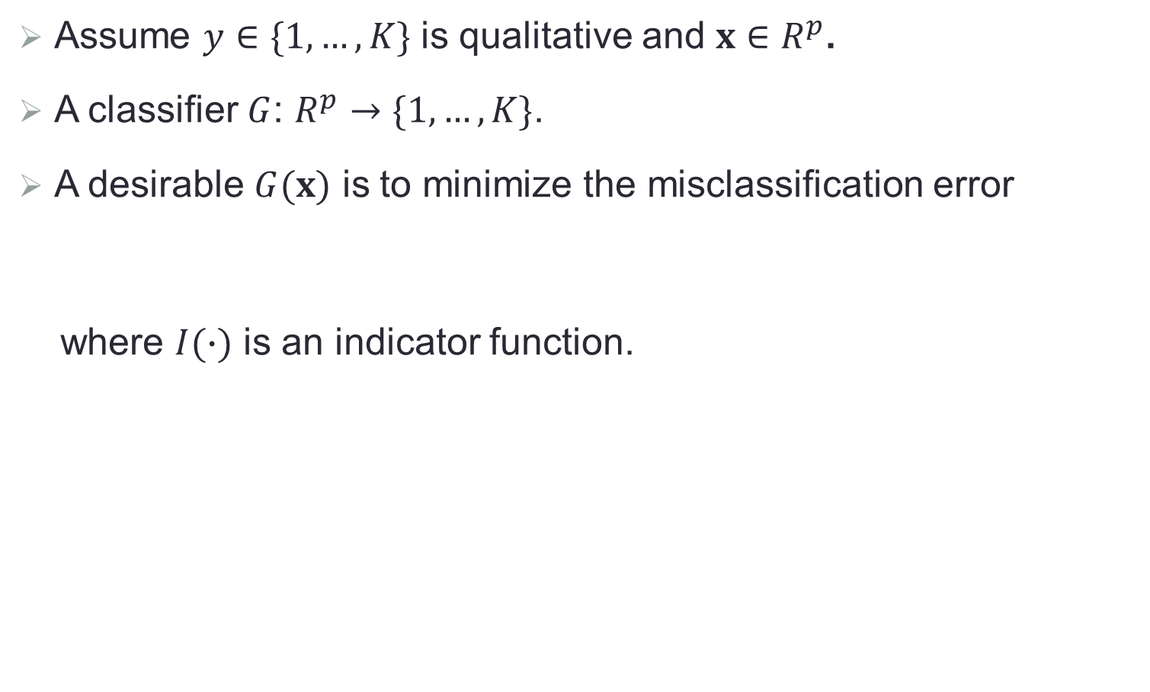
General Setup
Assume $y∈\{1,…,K\}$ is qualitative and $x∈R^{p}$.
A classifier $G$: $R^{p}→\{1,…,K\}$.
A desirable $G(x)$ is to minimize the misclassification error
where $I(∙)$ is an indicator function.
$$err\left(G\right)=P\left(y≠G\left(x\right)\right)=E\left(I\left(y≠G\left(x\right)\right)\right)$$

Slide 4
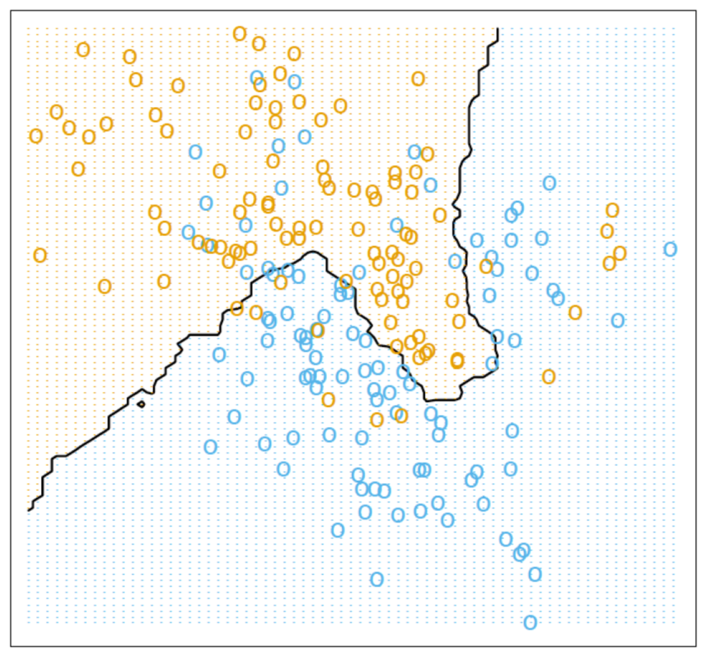
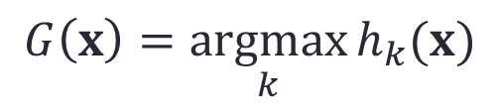
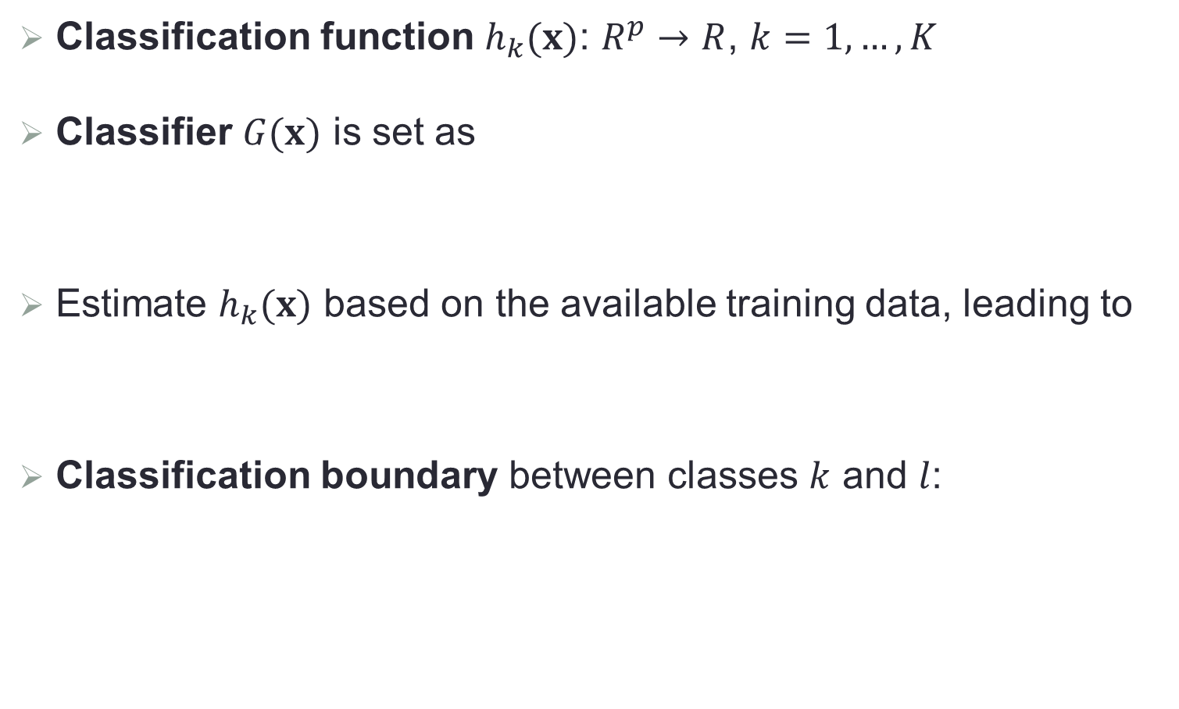

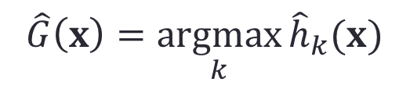
Some Concepts
Classification function $h_{k}(x)$: $R^{p}→R$, $k=1,…,K$
Classifier $G(x)$ is set as
Estimate $h_{k}(x)$ based on the available training data, leading to
Classification boundary between classes $k$ and $l$:
$$G\left(x\right)=\underset{k}{argmax}{h_{k}(x)}$$
$$\hat{G}\left(x\right)=\underset{k}{argmax}{{\hat{h}}_{k}(x)}$$
$$\{x:h_{k}\left(x\right)=h_{l}(x)\}$$

Slide 5
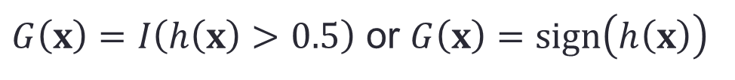
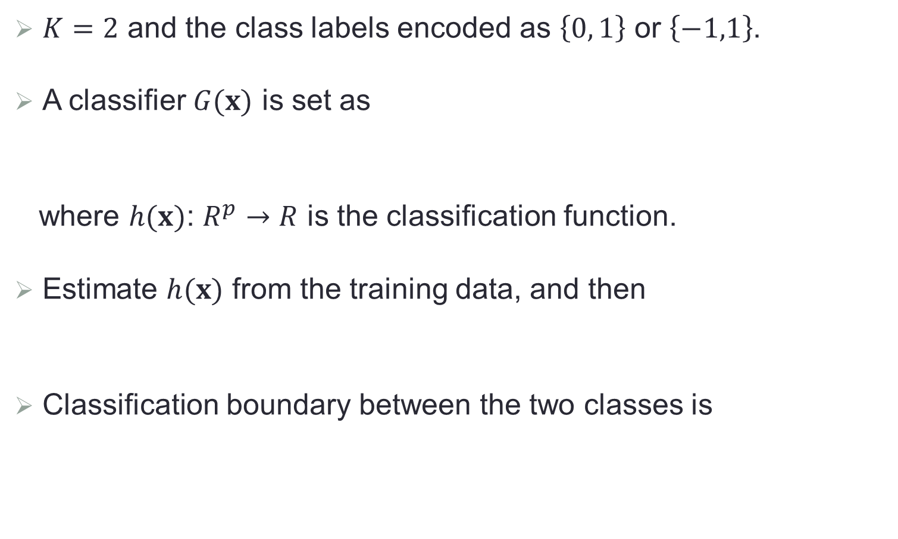
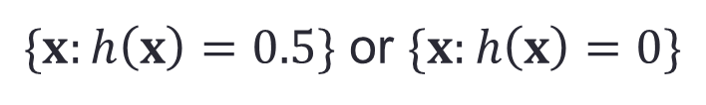
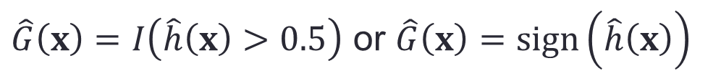
A Special Case: Binary Classification
$K=2$ and the class labels encoded as $\left\{0, 1\right\}$ or $\left\{−1,1\right\}$.
A classifier $G(x)$ is set as
where $h(x)$: $R^{p}→R$ is the classification function.
Estimate $h(x)$ from the training data, and then
Classification boundary between the two classes is
$G\left(x\right)=I\left(h\left(x\right)>0.5\right)$ or $G\left(x\right)=sign\left(h\left(x\right)\right)$
$\hat{G}\left(x\right)=I\left(\hat{h}\left(x\right)>0.5\right)$ or $\hat{G}\left(x\right)=sign\left(\hat{h}\left(x\right)\right)$
$\{x:h\left(x\right)=0.5\}$ or $\{x:h\left(x\right)=0\}$

Slide 6
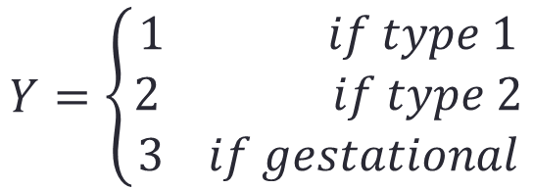
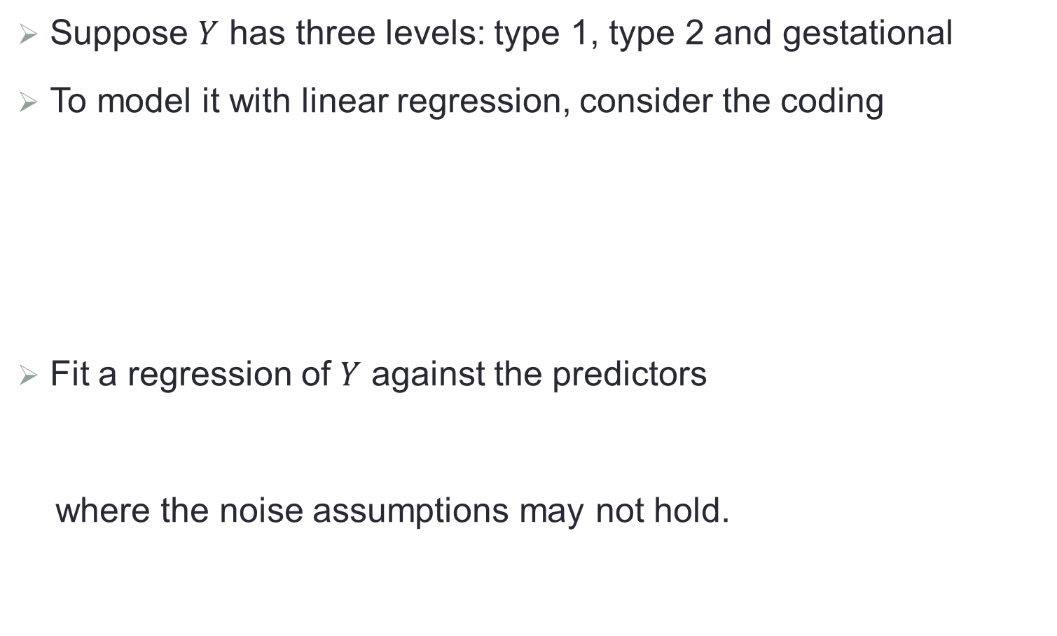

Linear Regression for Classification
Suppose $Y$ has three levels: type 1, type 2 and gestational
To model it with linear regression, consider the coding
Fit a regression of $Y$ against the predictors
where the noise assumptions may not hold.
$$Y=\left\{\begin{aligned}1 if type 1 \\ 2 if type 2 \\ 3 if gestational\end{aligned}\right.$$
$$Y=β_{0}+X^{T}β+ε$$

Slide 7
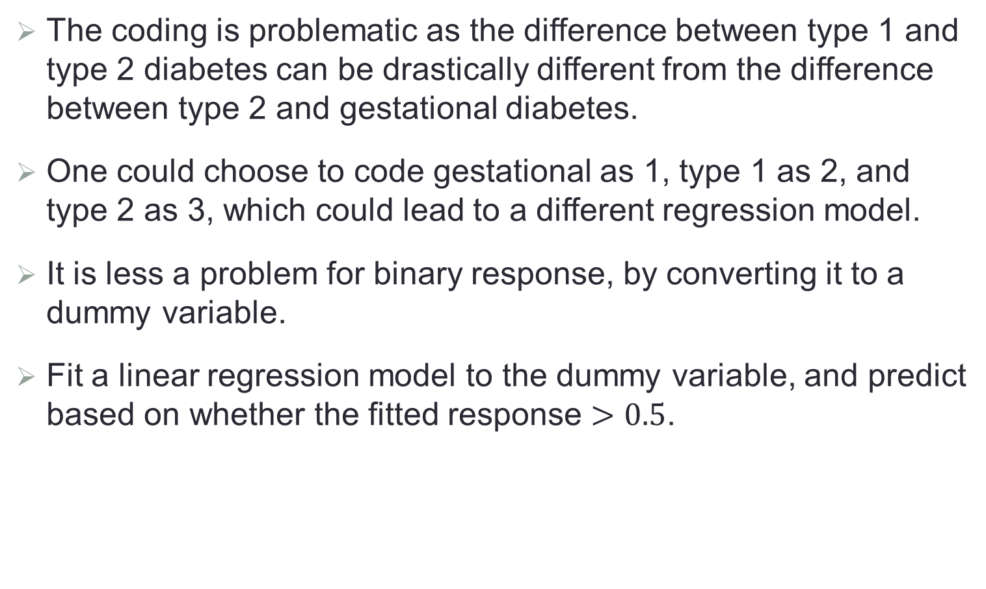
Issues about Coding
The coding is problematic as the difference between type 1 and type 2 diabetes can be drastically different from the difference between type 2 and gestational diabetes.
One could choose to code gestational as 1, type 1 as 2, and type 2 as 3, which could lead to a different regression model.
It is less a problem for binary response, by converting it to a dummy variable.
Fit a linear regression model to the dummy variable, and predict based on whether the fitted response $>0.5$.

Slide 8
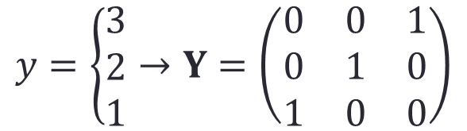
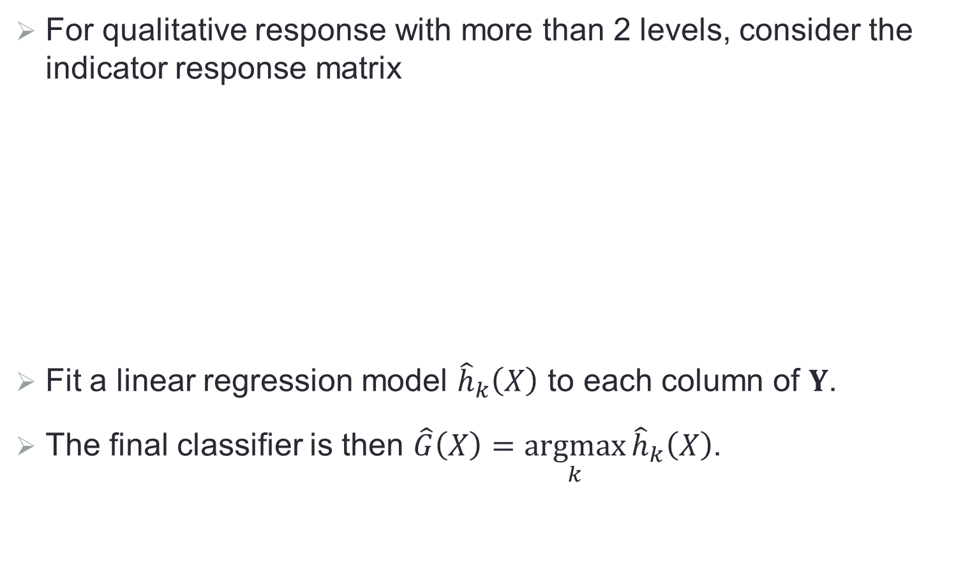
Coding with Dummy Variables
For qualitative response with more than 2 levels, consider the indicator response matrix
Fit a linear regression model ${\hat{h}}_{k}\left(X\right)$ to each column of $Y$.
The final classifier is then $\hat{G}\left(X\right)=\underset{k}{argmax}{{\hat{h}}_{k}\left(X\right)}$.
$$y=\left\{\begin{aligned}3 \\ 2 \\ 1\end{aligned}→Y=\left(\begin{matrix}0 & 0 & 1 \\ 0 & 1 & 0 \\ 1 & 0 & 0\end{matrix}\right)\right.$$

Slide 9
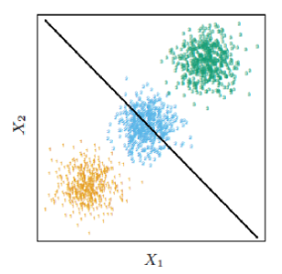
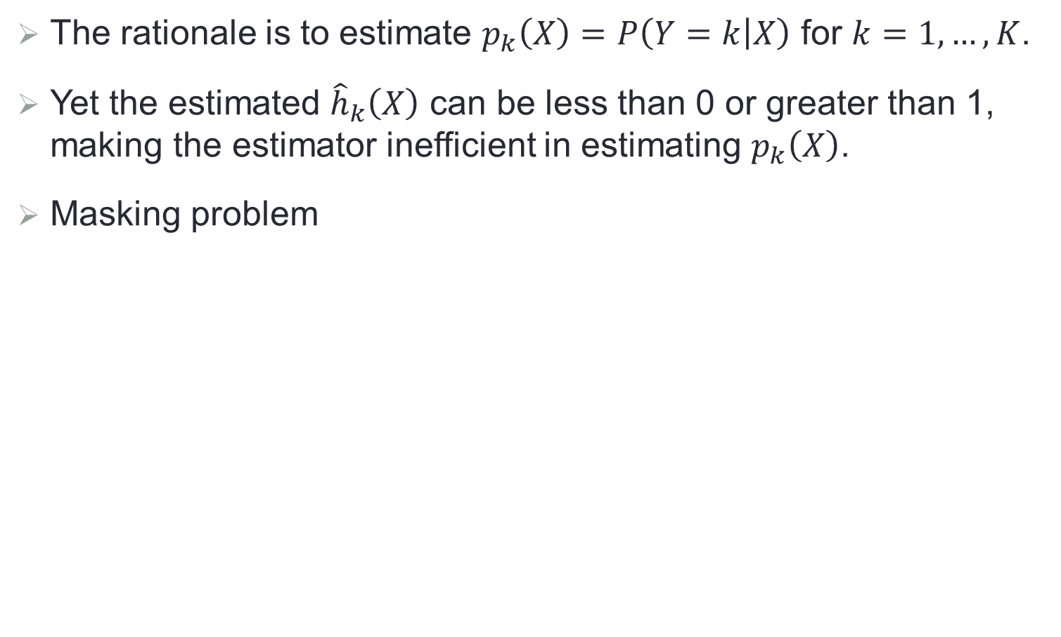
Further Issues
The rationale is to estimate $p_{k}\left(X\right)=P\left(Y=k | X\right)$ for $k=1,…,K$.
Yet the estimated ${\hat{h}}_{k}\left(X\right)$ can be less than 0 or greater than 1, making the estimator inefficient in estimating $p_{k}\left(X\right)$.
Masking problem

Slide 10
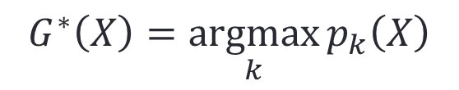
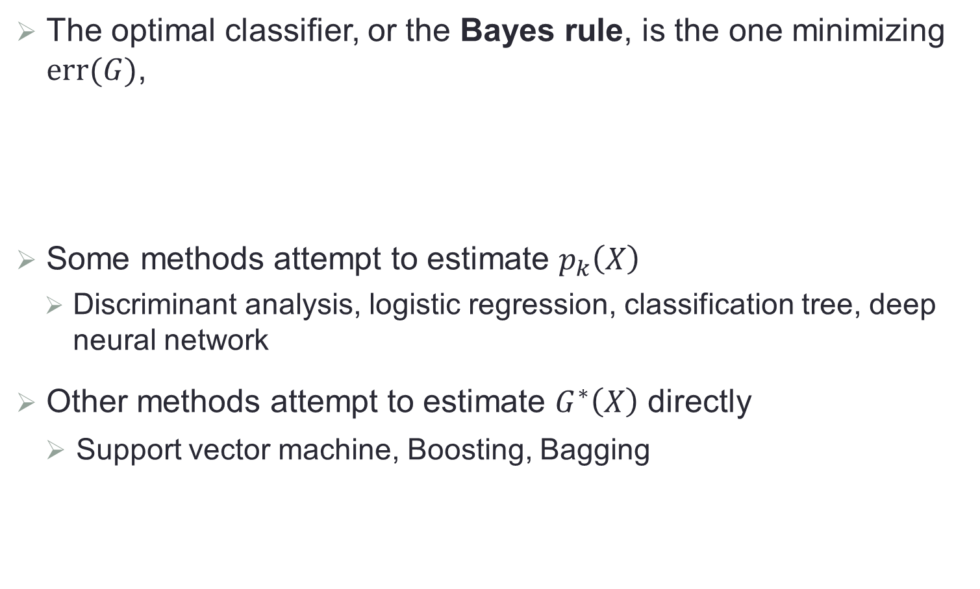
Bayes Rule
The optimal classifier, or the Bayes rule, is the one minimizing $err(G)$,
Some methods attempt to estimate $p_{k}\left(X\right)$
Discriminant analysis, logistic regression, classification tree, deep neural network
Other methods attempt to estimate $G^{∗}\left(X\right)$ directly
Support vector machine, Boosting, Bagging
$$G^{∗}\left(X\right)=\underset{k}{argmax}{p_{k}\left(X\right)}$$

Slide 11
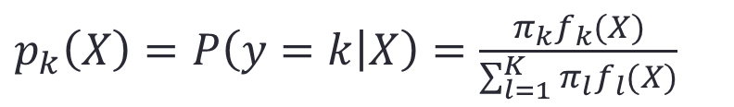
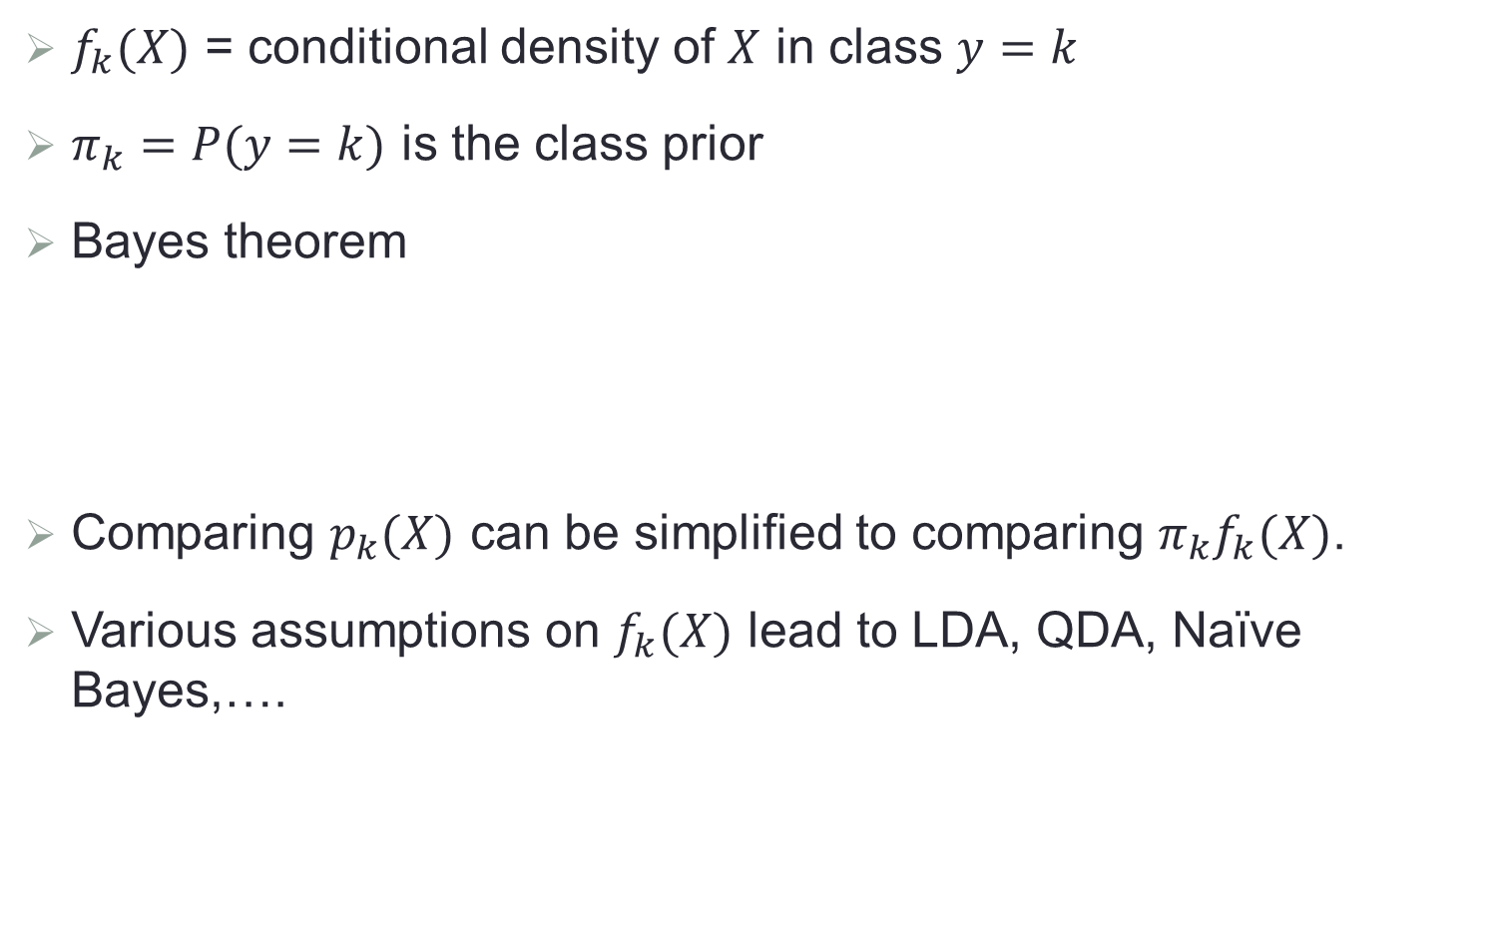
Discriminant Analysis
$f_{k}(X)$ = conditional density of $X$ in class $y=k$
$π_{k}=P(y=k)$ is the class prior
Bayes theorem
Comparing $p_{k}(X)$ can be simplified to comparing $π_{k}f_{k}(X)$.
Various assumptions on $f_{k}(X)$ lead to LDA, QDA, Naïve Bayes,….
$p_{k}\left(X\right)=P\left(y=k | X\right)=\frac{π_{k}f_{k}(X)}{\sum_{l=1}^{K}{π_{l}f_{l}(X)}}$

Slide 12
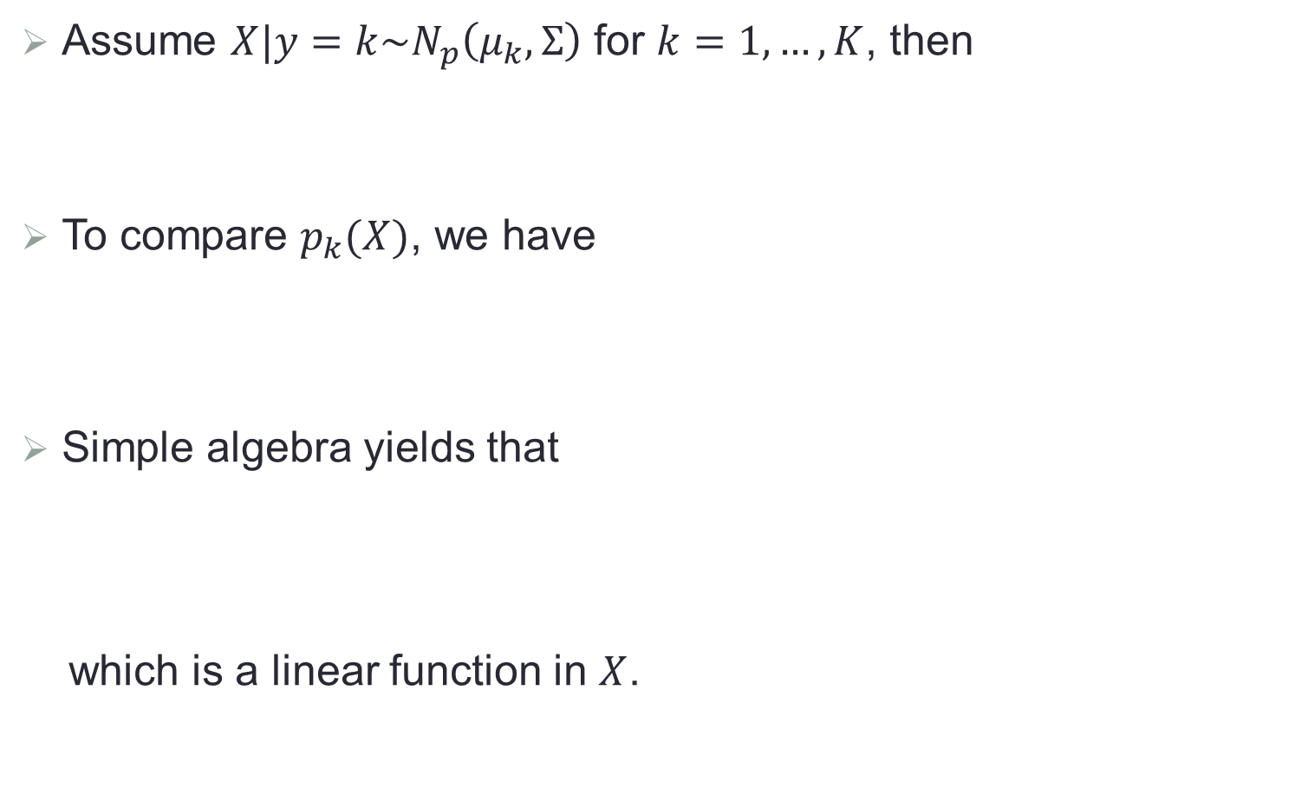
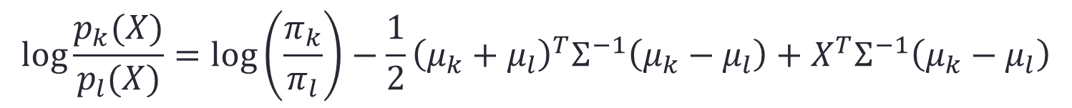
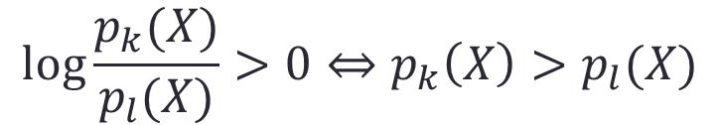
Linear Discriminant Analysis (LDA)
Assume $X|y=k\sim N_{p}\left(μ_{k},Σ\right)$ for $k=1,…,K$, then
To compare $p_{k}(X)$, we have
Simple algebra yields that
which is a linear function in $X$.
$f_{k}\left(X\right)=\frac{1}{{(2π)}^{1/2}{\left|Σ\right|}^{1/2}}exp\left\{−\frac{1}{2}{(X−μ_{k})}^{T}Σ^{−1}(X−μ_{k})\right\}$
$$log\frac{p_{k}(X)}{p_{l}(X)}>0⇔p_{k}\left(X\right)>p_{l}(X)$$
$$log\frac{p_{k}(X)}{p_{l}(X)}=\log\left(\frac{π_{k}}{π_{l}}\right)−\frac{1}{2}{\left(μ_{k}+μ_{l}\right)}^{T}Σ^{−1}\left(μ_{k}−μ_{l}\right)+X^{T}Σ^{−1}\left(μ_{k}−μ_{l}\right)$$

Slide 13
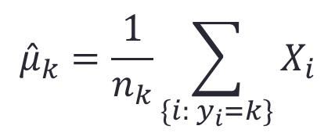
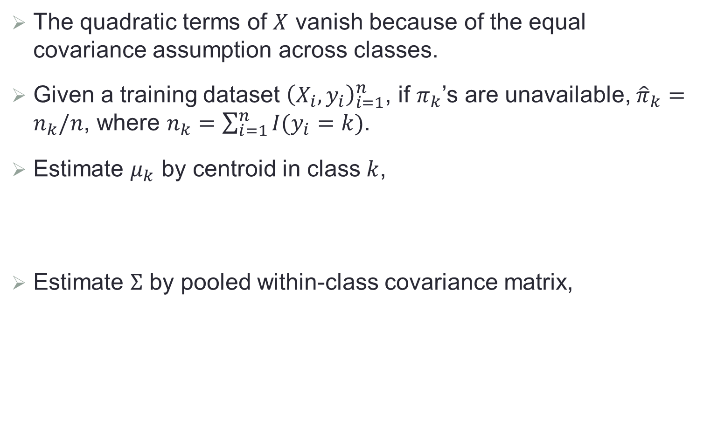
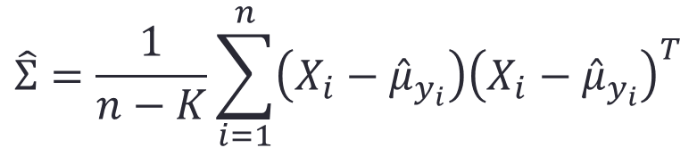
LDA (Cont.)
The quadratic terms of $X$ vanish because of the equal covariance assumption across classes.
Given a training dataset ${\left(X_{i},y_{i}\right)}_{i=1}^{n}$, if $π_{k}$’s are unavailable, ${\hat{π}}_{k}=n_{k}/n$, where $n_{k}=\sum_{i=1}^{n}{I(y_{i}=k)}$.
Estimate $μ_{k}$ by centroid in class $k$,
Estimate $Σ$ by pooled within-class covariance matrix,
$${\hat{μ}}_{k}=\frac{1}{n_{k}}\sum_{\{i: y_{i}=k\}}{X_{i}}$$
$$\hat{Σ}=\frac{1}{n−K}\sum_{i=1}^{n}{\left(X_{i}−{\hat{μ}}_{y_{i}}\right){\left(X_{i}−{\hat{μ}}_{y_{i}}\right)}^{T}}$$

Slide 14
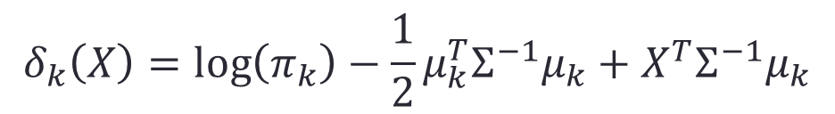
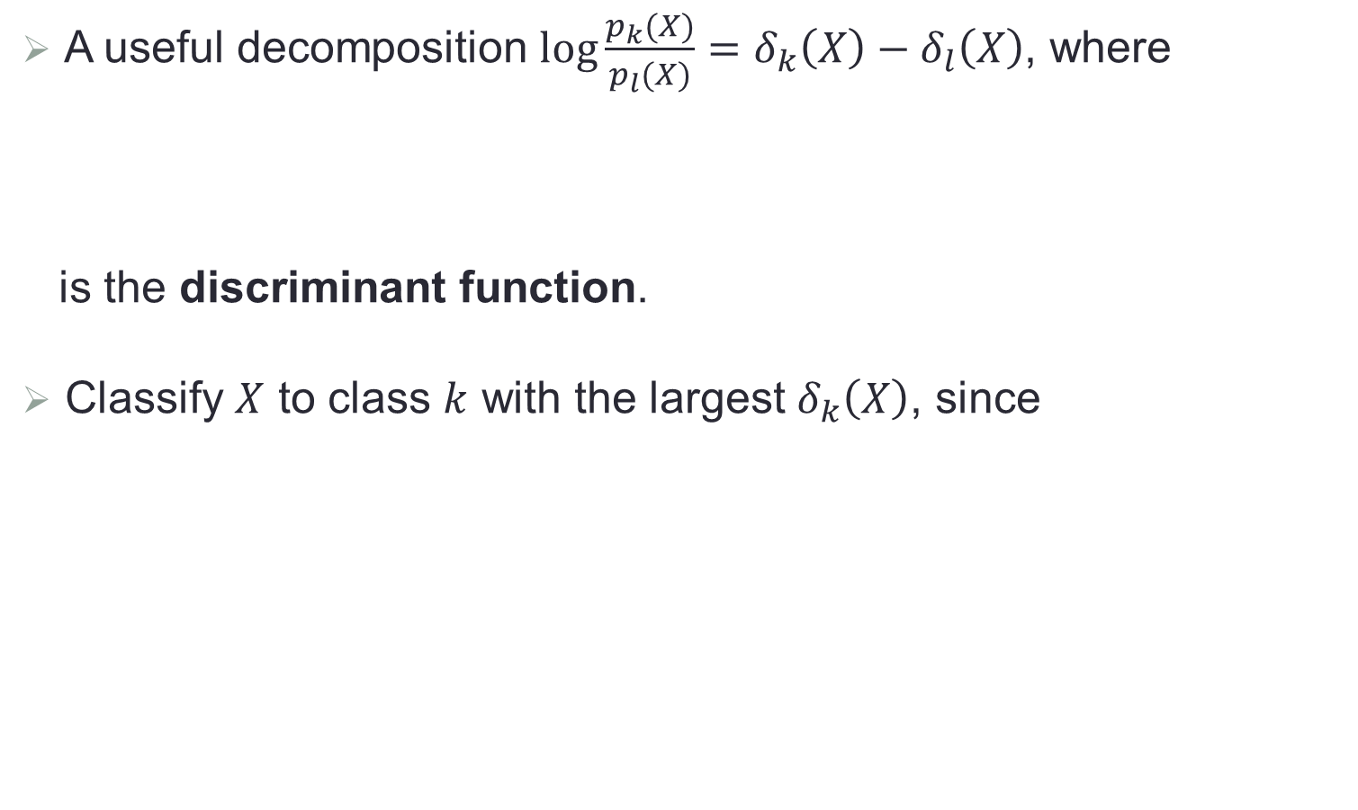
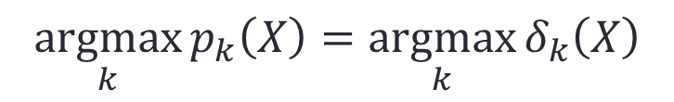
LDA (Cont.)
A useful decomposition $log\frac{p_{k}(X)}{p_{l}(X)}=δ_{k}\left(X\right)−δ_{l}\left(X\right)$, where
is the discriminant function.
Classify $X$ to class $k$ with the largest $δ_{k}\left(X\right)$, since
$$δ_{k}\left(X\right)=\log\left(π_{k}\right)−\frac{1}{2}μ_{k}^{T}Σ^{−1}μ_{k}+X^{T}Σ^{−1}μ_{k}$$
$$\underset{k}{argmax}{p_{k}\left(X\right)}=\underset{k}{argmax}{δ_{k}\left(X\right)}$$

Slide 15
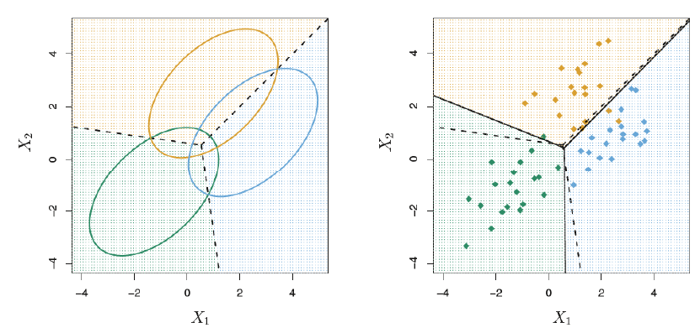
An Illustrative Example
Three normal distributions with same covariance and different means; 95% contours of constant density
Dashed: Bayes rule
Solid: LDA

Slide 16
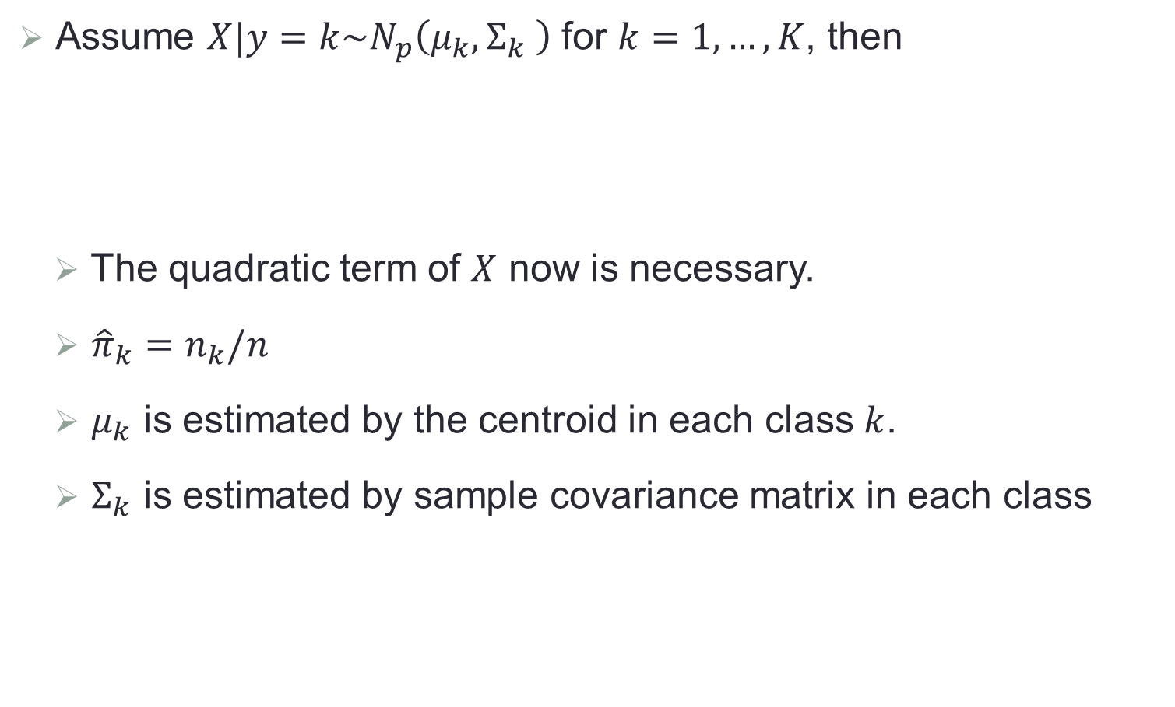
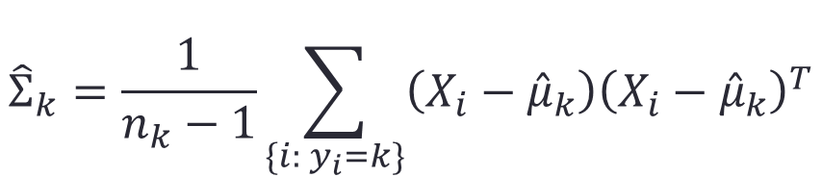
Quadratic Discriminant Analysis (QDA)
Assume $X|y=k\sim N_{p}\left(μ_{k},Σ_{k} \right)$ for $k=1,…,K$, then
The quadratic term of $X$ now is necessary.
${\hat{π}}_{k}=n_{k}/n$
$μ_{k}$ is estimated by the centroid in each class $k$.
$Σ_{k}$ is estimated by sample covariance matrix in each class
$$δ_{k}\left(X\right)=\log\left(π_{k}\right)−\frac{1}{2}log\left|Σ_{k}\right|−−\frac{1}{2}{(X−μ_{k})}^{T}{Σ_{k}}^{−1}(X−μ_{k})$$
$${\hat{Σ}}_{k}=\frac{1}{n_{k}−1}\sum_{\{i: y_{i}=k\}}{\left(X_{i}−{\hat{μ}}_{k}\right){\left(X_{i}−{\hat{μ}}_{k}\right)}^{T}}$$

Slide 17
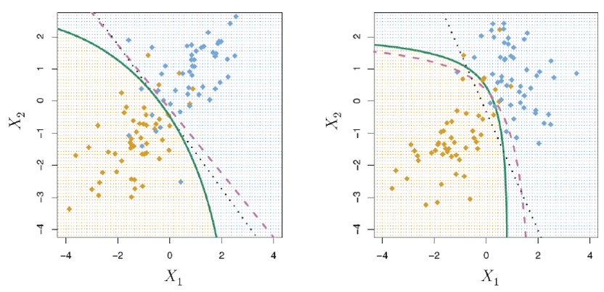
LDA and QDA
Purple: Bayes rule
Black: LDA
Green: QDA

Slide 18
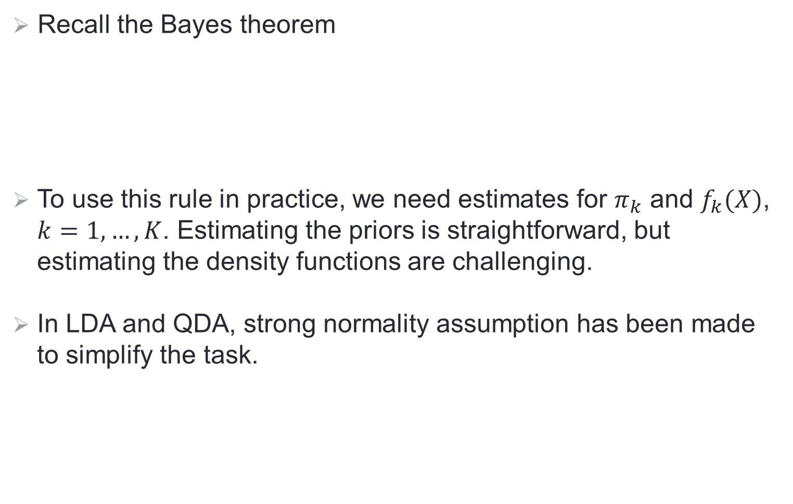
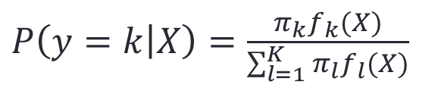
Naïve Bayes
Recall the Bayes theorem
To use this rule in practice, we need estimates for $π_{k}$ and $f_{k}(X)$, $k=1,…,K$. Estimating the priors is straightforward, but estimating the density functions are challenging.
In LDA and QDA, strong normality assumption has been made to simplify the task.
$P\left(y=k | X\right)=\frac{π_{k}f_{k}(X)}{\sum_{l=1}^{K}{π_{l}f_{l}(X)}}$

Slide 19
Naïve Bayes
The Naïve Bayes classifier does not assume the density functions belong to a particular family of distributions. It is based on another assumption: Within each class, the predictors are independent.
This means that for each class
By assuming the independence between predictors, we eliminate the need to figure out their associations, thus simplifying the estimation task.
We can estimate the density function of each predictor in different ways, such as assuming normality or using non-parametric methods.
$f_{k}\left(X\right)=$ $f_{k1}\left(x_{1}\right)×f_{k2}\left(x_{2}\right)×⋯×f_{kp}\left(x_{p}\right)$

Slide 20
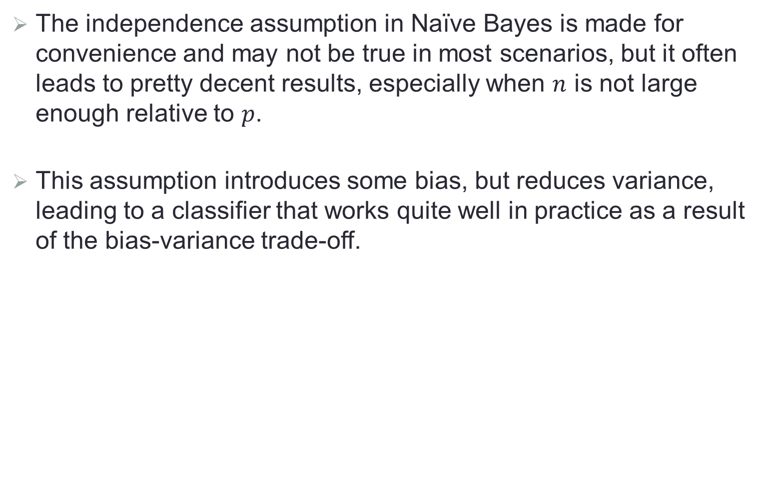
Performance of Naïve Bayes
The independence assumption in Naïve Bayes is made for convenience and may not be true in most scenarios, but it often leads to pretty decent results, especially when $n$ is not large enough relative to $p$.
This assumption introduces some bias, but reduces variance, leading to a classifier that works quite well in practice as a result of the bias-variance trade-off.

Slide 21
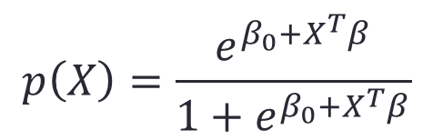
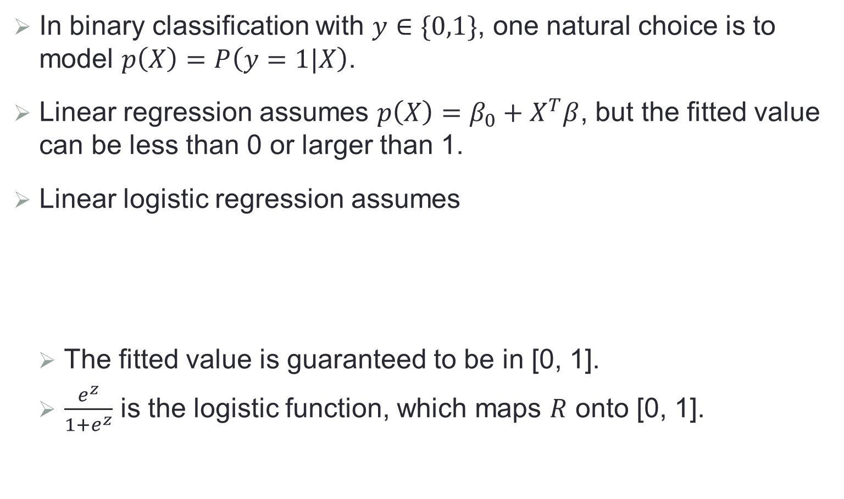
Binary Logistic Regression
In binary classification with $y∈\{0,1\}$, one natural choice is to model $p\left(X\right)=P\left(y=1|X\right)$.
Linear regression assumes $p\left(X\right)=β_{0}+X^{T}β$, but the fitted value can be less than 0 or larger than 1.
Linear logistic regression assumes
The fitted value is guaranteed to be in [0, 1].
$\frac{e^{z}}{1+e^{z}}$ is the logistic function, which maps $R$ onto [0, 1].
$$p\left(X\right)=\frac{e^{β_{0}+X^{T}β}}{1+e^{β_{0}+X^{T}β}}$$

Slide 22
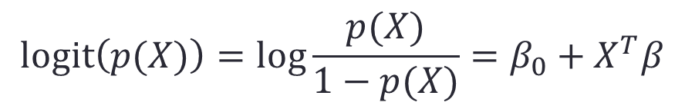
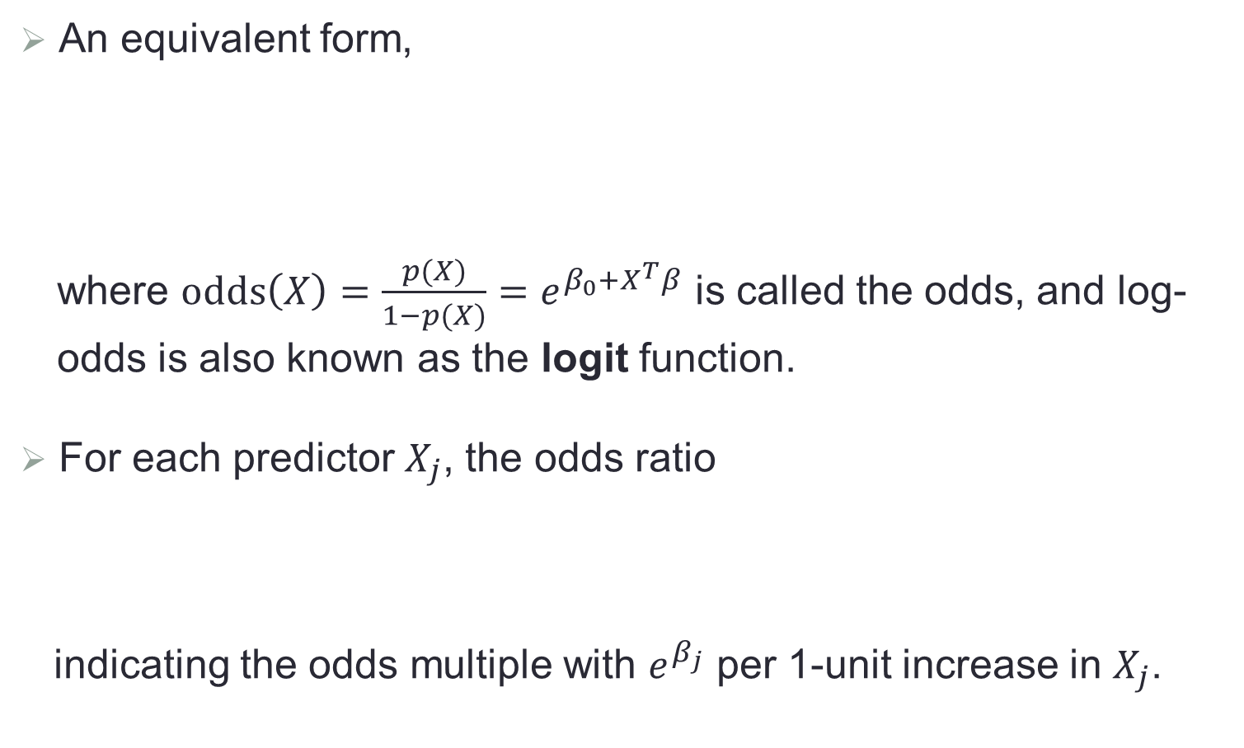
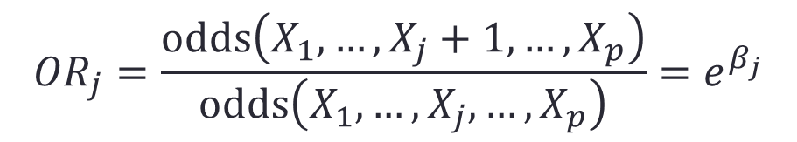
Logit and Odds Ratio
An equivalent form,
where $odds\left(X\right)=\frac{p(X)}{1−p(X)}=e^{β_{0}+X^{T}β}$ is called the odds, and log-odds is also known as the logit function.
For each predictor $X_{j}$, the odds ratio
indicating the odds multiple with $e^{β_{j}}$ per 1-unit increase in $X_{j}$.
$$logit\left(p(X)\right)=log\frac{p(X)}{1−p(X)}=β_{0}+X^{T}β$$
$${OR}_{j}=\frac{odds\left(X_{1},…,X_{j}+1,…,X_{p}\right)}{odds\left(X_{1},…,X_{j},…,X_{p}\right)}=e^{β_{j}}$$

Slide 23
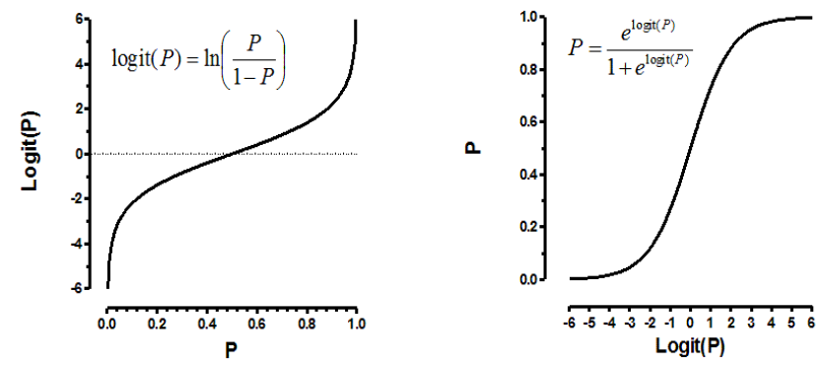
Logit Function

Slide 24
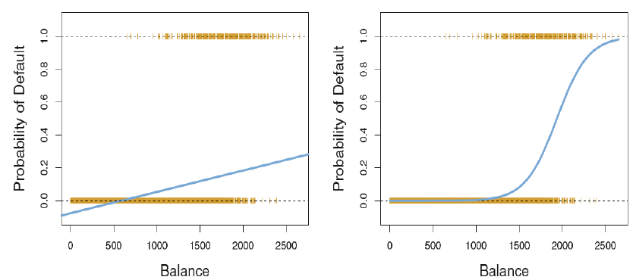
Comparison b/w Linear and Logistic Regression

Slide 25
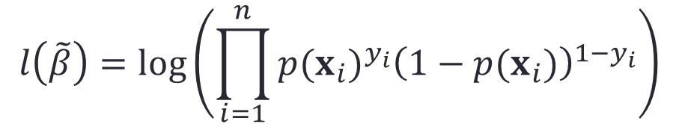
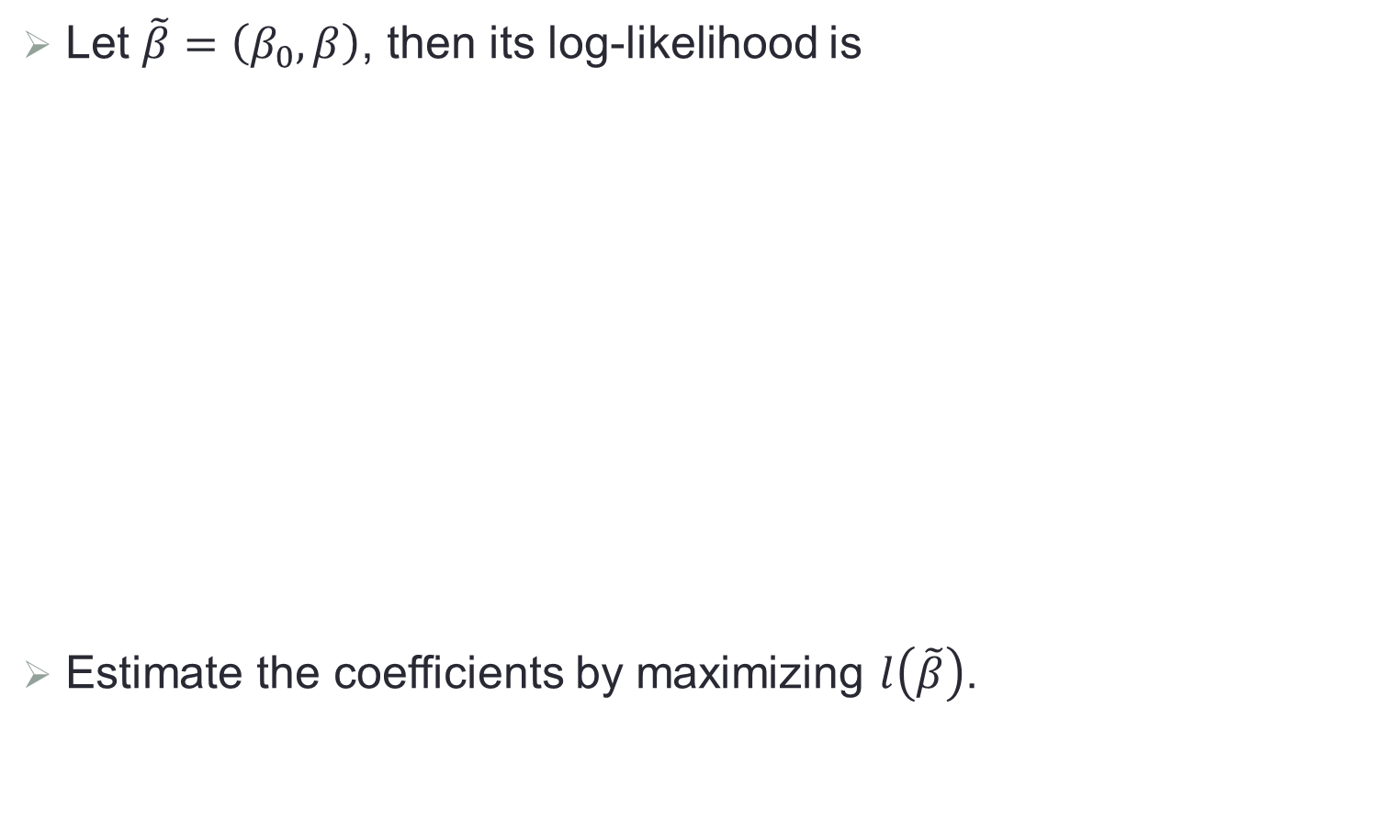
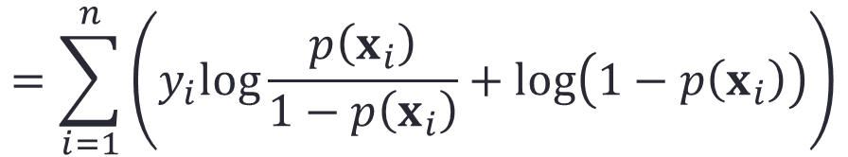
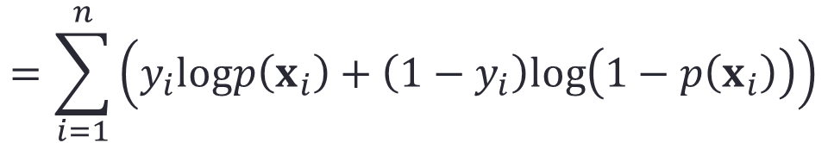
Fitting Binary Logistic Regression
Let $\tilde{β}=\left(β_{0},β\right)$, then its log-likelihood is
Estimate the coefficients by maximizing $l\left(\tilde{β}\right)$.
$$l\left(\tilde{β}\right)=log\left(\prod_{i=1}^{n}{{p(x_{i})}^{y_{i}}{\left(1−p(x_{i})\right)}^{1−y_{i}}}\right)$$
$$=\sum_{i=1}^{n}{\left(y_{i}logp\left(x_{i}\right)+\left(1−y_{i}\right)log\left(1−p\left(x_{i}\right)\right)\right)}$$
$$=\sum_{i=1}^{n}{\left(y_{i}log\frac{p\left(x_{i}\right)}{1−p\left(x_{i}\right)}+log\left(1−p\left(x_{i}\right)\right)\right)}$$

Slide 26
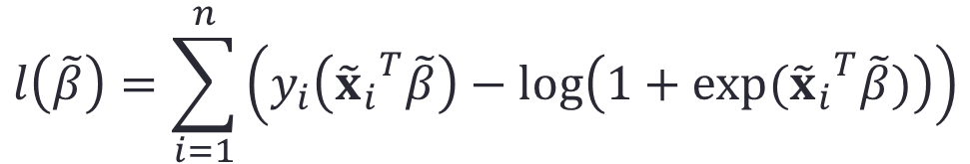
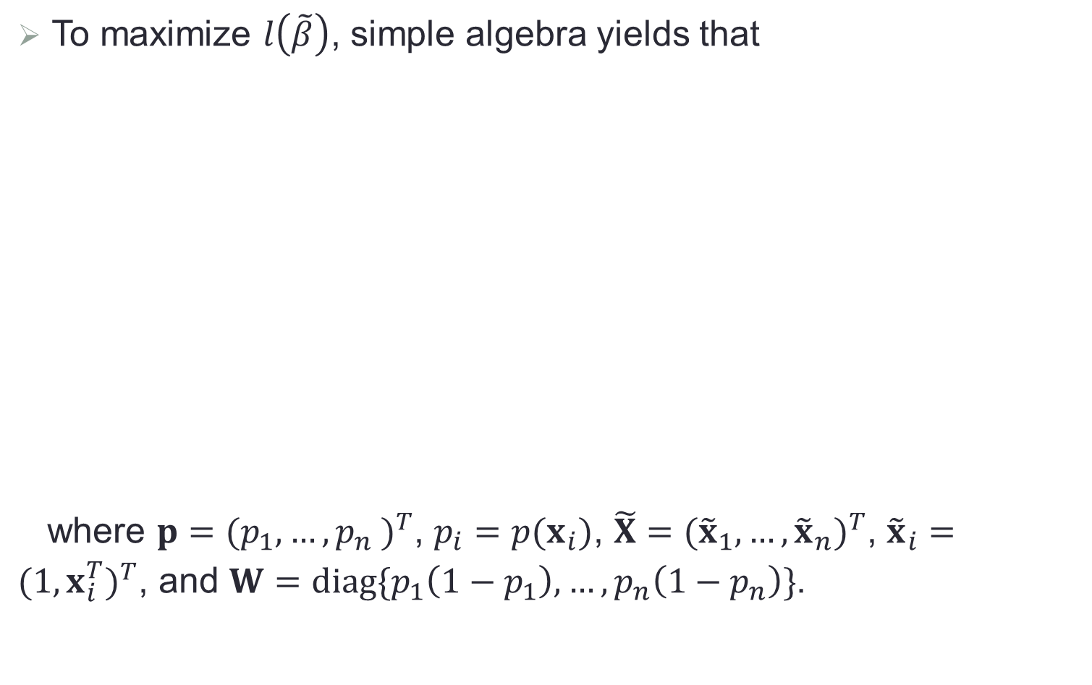
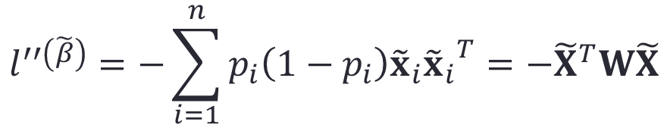

MLE for Logistic Regression
To maximize $l\left(\tilde{β}\right)$, simple algebra yields that
where $p={(p_{1},…,{p_{n}}_{ })}^{T}$, $p_{i}=p(x_{i})$, $\tilde{X}={({\tilde{x}}_{1},…,{\tilde{x}}_{n})}^{T}$, ${\tilde{x}}_{i}={(1,x_{i}^{T})}^{T}$, and $W=diag\{p_{1}\left(1−p_{1}\right),…,p_{n}\left(1−p_{n}\right)\}$.
$$l\left(\tilde{β}\right)=\sum_{i=1}^{n}{\left(y_{i}\left({{\tilde{x}}_{i}}^{T}\tilde{β}\right)−log\left(1+exp⁡({{\tilde{x}}_{i}}^{T}\tilde{β})\right)\right)}$$
$$l^{′\left(\tilde{β}\right)}=\sum_{i=1}^{n}{\left(y_{i}−p_{i}\right){\tilde{x}}_{i}}={\tilde{X}}^{T}(y−p)$$
$$l^{′′\left(\tilde{β}\right)}=−\sum_{i=1}^{n}{p_{i}\left(1−p_{i}\right){\tilde{x}}_{i}{{\tilde{x}}_{i}}^{T}}=−{\tilde{X}}^{T}W\tilde{X}$$

Slide 27



Iteratively Reweighted Least Square (IRLS)
Newton’s method updates $β$ iteratively,
In the last two lines we have re-expressed the Newton-Raphson step as a weighted least squares step, with the new response
This is also to iteratively refit the linear regression model with new weights and responses, and thus the name IRLS.
$${\tilde{β}}^{new}={\tilde{β}}^{old}+{({\tilde{X}}^{T}W\tilde{X})}^{−1}\left({\tilde{X}}^{T}(y−p)\right)$$
$$={({\tilde{X}}^{T}W\tilde{X})}^{−1}{\tilde{X}}^{T}W\left(\tilde{X}{\tilde{β}}^{old}+W^{−1}(y−p)\right)$$
$$={({\tilde{X}}^{T}W\tilde{X})}^{−1}{\tilde{X}}^{T}Wy^{new}$$
$$y^{new}=\tilde{X}{\tilde{β}}^{old}+W^{−1}(y−p)$$

Slide 28



Multiclass Logistic Regression
Multiclass logistic regression assumes
Coefficients are also estimated by MLE based on the likelihood function of multinomial distribution.
$$log\frac{p_{1}(X)}{p_{K}(X)}={\tilde{x}}^{T}{\tilde{β}}_{1}$$
$$log\frac{p_{2}(X)}{p_{K}(X)}={\tilde{x}}^{T}{\tilde{β}}_{2}$$
$$log\frac{p_{K−1}(X)}{p_{K}(X)}={\tilde{x}}^{T}{\tilde{β}}_{K−1}$$

Slide 29



Probit Model
In binary classification, probit model assumes
where $Φ$ is the cumulative distribution function of standard normal distribution.
$$p\left(x\right)=Φ(β_{0}+x^{T}β)$$

Slide 30


Logistic Regression and LDA
In binary classification, LDA also leads to
where $c_{0}=log\left(\frac{π}{1−π}\right)−\frac{1}{2}{\left(μ_{1}+μ_{0}\right)}^{T}Σ^{−1}\left(μ_{1}+μ_{0}\right)$ and $c_{1}=$ $Σ^{−1}\left(μ_{1}−μ_{0}\right)$.
Thus logistic regression and LDA differ only in their fitting procedures
Logistic regression estimates the coefficients by MLE.
LDA estimates them based on the estimated mean and covariance matrix of a normal distribution.
$$logit\left(p(x)\right)=log\frac{p(x)}{1−p(x)}=c_{0}+x^{T}c_{1}$$

Slide 31

Separating Hyperplane
This method constructs linear classification boundaries that try to separate the data into different classes as well as possible.

Slide 32

Geometric View of Classification
Feature space
  Space formed by the predictors
  Also referred to as the state space, input space
  $p$-dimensional ($p$ predictors), $n$-points ($n$ observations)
Training data
  Inputs determine the location in the feature space
  Outputs determine the color (i.e., classes)
Classification: Find the hyperplane such that a test point
is assigned the correct class.

Slide 33


Hyperplane
In a $p$-dimensional space, a hyperplane is a flat affine subspace of dimension $p−1$. For example, in a two-dimensional space, a hyperplane is a line.
$$(X_{1},X_{2})$$

Slide 34



Review of Vector Algebra
A hyperplane $L$ is defined by the linear equation:
For any two points $x_{1}$ and $x_{2}$ lying in $L$, ${\left(x_{1}−x_{2}\right)}^{T}β=0$, and hence $β^{∗}=β/\left\|β\right\|$ is the vector normal to the surface of $L$.
For any point $x_{0}$ in $L$, ${x_{0}}^{T}β=−β_{0}$.
The signed distance of any point $x$ to $L$ is given by
$$L=\{x:f\left(x\right)=β_{0}+x^{T}β=0\}$$
$${\left(x−x_{0}\right)}^{T}β^{∗}=\frac{1}{\left\|β\right\|}\left(x^{T}β+β_{0}\right)$$

Slide 35

Geometry of A Hyperplane

Slide 36

Separating Hyperplane
Separating hyperplane: separates the training observations perfectly according to their class labels
Blue: class 1 ($y=1$)
Purple: class ‒1 ($y=−1$)
$f\left(x\right)=β_{0}+β_{1}x_{1}+β_{2}x_{2}+…+β_{p}x_{p}$
class 1: $f\left(x\right)>0$
class ‒1: $f\left(x\right)<0$
Property: $y_{i}f\left(x_{i}\right)>0$, for all training points $x_{1},x_{2},…,x_{n}$

Slide 37

Prediction
Given a test point $x^{∗}$, we will assign it to
class 1 ($y^{∗}=1$), if $f\left(x^{∗}\right)>0$
class ‒1 ($y^{∗}=−1$), if $f\left(x^{∗}\right)<0$
If $y^{∗}f\left(x^{∗}\right)$ is far from zero, that means the test point lies far from the hyperplane, and so we can be confident about our class assignment for it.
If $y^{∗}f\left(x^{∗}\right)$ is close to zero, that means the test point is located near the hyperplane, and so we are less certain about the class assignment for it.

Slide 38
How to Do It Right?
There may be an infinite number of hyperplanes that separates the training observations perfectly.
We need to decide which hyperplane to use.

Slide 39

Margin
Suppose we have a separating hyperplane
Find perpendicular distance from every point to the hyperplane
Margin: The smallest of such distances, $M$
  i.e., minimum distance from the observations to the hyperplane

Slide 40
Maximal Margin Classifier
Maximize min-distance (max margin)
Represent the mid-line of the widest “slab” inserted between the two classes
Best linear boundary

Slide 41



Optimal Separating Hyperplane
Consider binary classification with $y_{i}∈\{1, −1\}$.
Suppose the two classes can be linearly separated.
Optimal separating hyperplane separates the two classes and maximizes the distance to the closest point from either class.
Tend to have better classification performance on test data
That is, every point is at least $C$ away from the decision boundary $β_{0}+x^{T}β=0$.
$$\max_{β,β_{0}}{ C}$$
subject to $\frac{1}{\left\|β\right\|}y_{i}\left({x_{i}}^{T}β+β_{0}\right)≥C$, $i=1,…,n$

Slide 42




Estimation
For any solution of the optimization problem, any positively scaled multiple is a solution as well.
Set $\left\|β\right\|=1/C$ and the optimization is equivalent to
The Lagrange function is
$$\min_{β,β_{0}}{ \frac{1}{2}{\left\|β\right\|}^{2}}$$
subject to $y_{i}\left({x_{i}}^{T}β+β_{0}\right)≥1$, $i=1,…,n$
$$L_{p}=\min_{β,β_{0}}{\frac{1}{2}{\left\|β\right\|}^{2}−\sum_{i=1}^{n}{α_{i}\left(y_{i}\left({x_{i}}^{T}β+β_{0}\right)−1\right)}}$$
subject to $α_{i}≥0$

Slide 43





Estimation (Cont.)
Setting derivative to zero, we have
Substitute into $L_{p}$, the Wolfe dual form is
This can be solved by quadratic programming.
$$β=\sum_{i=1}^{n}{α_{i}y_{i}x_{i}}$$
$$0=\sum_{i=1}^{n}{α_{i}y_{i}}$$
and
$$L_{D}=\max_{α}{\sum_{i=1}^{n}{α_{i}}−\frac{1}{2}\sum_{i=1}^{n}{\sum_{j=1}^{n}{α_{i}α_{j}y_{i}}y_{j}{x_{i}}^{T}x_{j}}}$$
subject to $α_{i}≥0$ and $\sum_{i=1}^{n}{α_{i}y_{i}=0}$

Slide 44




Linear and Quadratic Programming
Linear programming (LP)
Quadratic programming (QP)
Implementation is available in most software.
$$\min_{z}{c^{T}}z$$
subject to $Az≤b$ and $z≥0$
$$\min_{z}{\frac{1}{2}z^{T}Qz+}c^{T}z$$
subject to $Az≤b$

Slide 45


Evaluating Classification Model
Misclassification error
Receiver operating characteristics (ROC) curve
$$test error=\frac{1}{\left|test set\right|}\sum_{i∈test set}{I\left(\hat{G}(x_{i})≠y_{i}\right)}$$

Slide 46


Other Performance Measures
A few popularly-used terms
True positive rate or Sensitivity or Recall $=TP/P$
False positive rate or 1$−$Specificity $=FP/N$
Positive predictive value or Precision$=TP/P^{∗}$
F1-score $=$ $2×\frac{Precision×Recall}{Precision+Recall}$
Area under the ROC curve (AUC)
Youden index is $J=Sensitivity+Specificity−1$

Slide 47

Example
Response: Whether a person will default his/her credit card payment (Yes/No = 1/0)
Misclassification error rate: fraction of people that are incorrectly classified (2.75%)
Sensitivity (true positive rate): fraction of defaulters that are correctly identified (24.3%)
Specificity: fraction of non-defaulters that are correctly identified as non-defaulters (99.76%)
False positive rate (1– Specificity): fraction of non-defaulters that are incorrectly classified as defaulters (0.24%)

